Slide 1
BREAST CANCER DETECTION
PROJECT II
Minor Project [Sem VI]
Based on MACHINE LEARNING
FULL STACK Project

Slide 2
Our Team
Manvi Vrati 190136
Pranjal Tulsiyan 190119
Saloni Chawla 190078

Slide 3
Table of Contents
/01
ABSTRACT
/02
RELEVANCE & FEASABILITY
/03
METHODOLOGY
/04
PROJECT DESIGN
A Basic Introduction to Breast Cancer and ML used for it
Requirement and necessity of this code
Steps for creating the project
Work flow [FLOWCHART]

Slide 4
Table of Contents
/05
TECHNOLOGY
/06
Working
/07
LIMITATIONS & FUTURE SCOPE
/08
CONCLUSION
Tools and technology used
Explaination of steps executed
Challenges and scope for work
Accuracy, results derived & timeline.

Slide 5
/01
ABSTRACT
Breast Cancer Introduction

Slide 6
Breast Cancer
Breast cancer is one of the most common cancers among women worldwide, representing the majority of new cancer cases and cancer-related deaths according to global statistics, making it a significant public health problem in today’s society.
Worldwide, breast cancer is the most common type of cancer in women and the second highest in terms of mortality rates.
Diagnosis of breast cancer is performed when an abnormal lump is found (from self-examination or x-ray) or a tiny speck of calcium is seen (on an x-ray).
After a suspicious lump is found, the doctor will conduct a diagnosis to determine whether it is cancerous and, if so, whether it has spread to other parts of the body.
With the help of machine learning we will be predicting if it is cancer by examining the lump.

Slide 7
—CYTECARE CANCER HOSPITAL
“It is reported that within every four minutes, an Indian woman is diagnosed with breast cancer.”

Slide 8
/02
RELEVANCE & FEASABILITY
Requirement and necessity

Slide 9
<About 800,000>
<Around 162,468 >
<As in 2021, 1 in 28>
New cancer cases occur in India every year. [Including all kinds on Cancer]
Amongst them are new breast cancer cases and 87,090 reported deaths.
Woman tends to develop breast cancer
[More in Urban areas as compared to rural areas]

Slide 10
DETECTION ON TIME IS A MUST!
Breast cancer is the most common cancer among women in 154 countries and the main cause of cancer-related death in 103 countries. The mortality rate Is approximately 15.0% .
The early diagnosis of Breast Cancer can improve the prognosis and chance of survival significantly, as it can promote timely clinical treatment to patients.
We can use techniques to make tools for doctors that can be used as an effective mechanism for early detection which could greatly enhance the survival rate of patients.
Machine learning algorithms can be used for medical oriented research, it advances the system, reduces human errors and lowers manual mistakes.

Slide 11
/03
METHODOLOGY
Steps of execution

Slide 12
STEPS [Machine learning work flow]
Collecting dataset
Understanding the data
Data pre-processing
Split data into training , validation & testing data
Train the model
Result improvement

Slide 13
/04
PROJECT DESIGN
Work flow of project

Slide 14
Importing modules required
Collecting dataset
Data pre-processing
Train the model
Analysis and evaluation
Component designing
Front End
Combining components with ML
Final Testing
F
U
L
L
S
T
A
C
K
PROJECT

Slide 15
/05
TECHNOLOGY
Tools and technologies involved

Slide 16




Tools used:
SKLEARN
JUPYTER
DJANGO
BOOTSTRAP
To access database having large amount of data.
To run ML models and train and test it.
For developing a full stack project. It is a web based framework.
For the frontend development and responsiveness. Used with HTML and CSS.

Slide 17
/06
WORKING
Three ML models implemented are:-

Slide 18
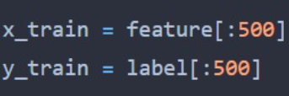
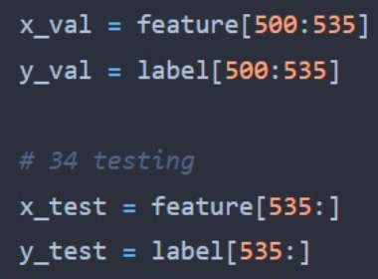
Data Set Division:
Training
Validation
Testing
85% Approximately
15% Approximately

Slide 19
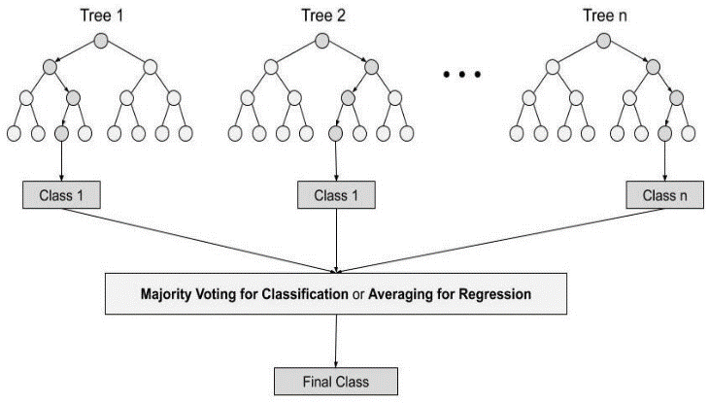
Random Forest Classifier
Supervised learning algorithm used in both
classification and regression problems.
Most flexible and easy to use.
Applications: Recommendation engines, image classification,
feature selection, classify loyal loan applicants,
identify fraudulent activity and predict diseases.
Four steps of Working:
Select random samples from a given dataset.
Construct a decision tree for each sample and
get a prediction result from each decision tree.
3. Perform a vote for each predicted result.
4. Select the prediction result with the most votes as the final prediction.
Advantages:
Highly accurate and robust method
Does not suffer from the overfitting problem
Also handle missing values
Notes:
Regression is a process of finding the correlations between dependent and independent variables. It helps in predicting the continuous variables such as prediction of Market Trends, prediction of House prices, etc. Suppose we want to do weather forecasting, so for this, we will use the Regression algorithm. In weather prediction, the model is trained on the past data, and once the training is completed, it can easily predict the weather for future days. The output variable must be of continuous nature or real value. Continuous data.
Classification is a process of finding a function which helps in dividing the dataset into classes based on different parameters. In Classification, a computer program is trained on the training dataset and based on that training, it categorizes the data into different. The output variable must be a discrete value. Discrete data.
Supervised Learning: Supervised learning is the types of machine learning in which machines are trained using well "labelled" training data, and on basis of that data, machines predict the output. The labelled data means some input data is already tagged with the correct output.

Slide 20
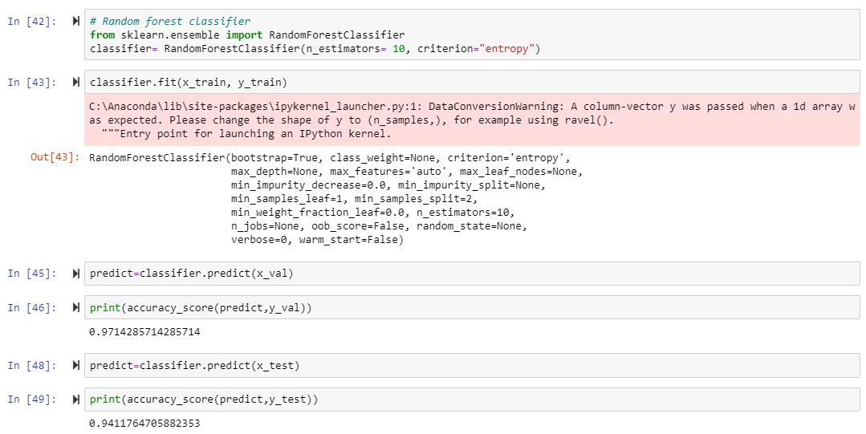
Notes:
x_train: input data, y_train: output data.
.fit() used for training with output arguments are 2 arrays in supervised learning.
.predict() predicts values according to input. Used for testing. Used to predict the labels of the data values on the basis of the trained model.
The accuracy_score(): method is used to calculate the accuracy of either the faction or count of correct prediction in Python Scikit learn. Mathematically it represents the ratio of the sum of true positives and true negatives out of all the predictions. Accuracy Score = (TP+TN)/ (TP+FN+TN+FP)
Libraries imported: from sklearn.metrics import accuracy_score, from sklearn.ensemble importRandomForestClassifier, from Sklearn import svm, from sklearn.linear_model import Logistic Regression

Slide 21
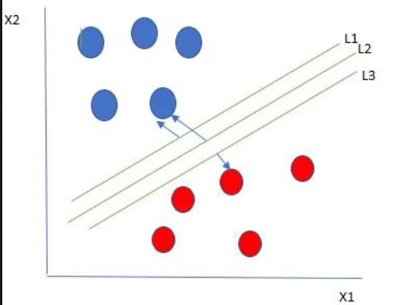
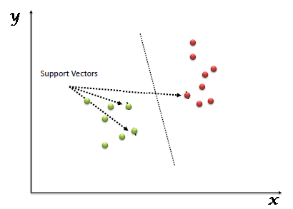
SVM
Support Vector Machine or SVM
Supervised Learning algorithm.
Used for Classification as well as Regression problems.
Objective: to find a hyperplane in an N-dimensional space that distinctly classifies the data points. Dimensions depend upon number of features:
If it is two, then hyperplane is just a line
If it is three, then hyperplane is a 2-D plane.
It becomes difficult to imagine when the number of features exceeds three.
Best hyperplane: largest separation or margin between the two classes. So we choose the hyperplane whose distance from it to the nearest data point on each side is maximized.
Here choose L2

Slide 22
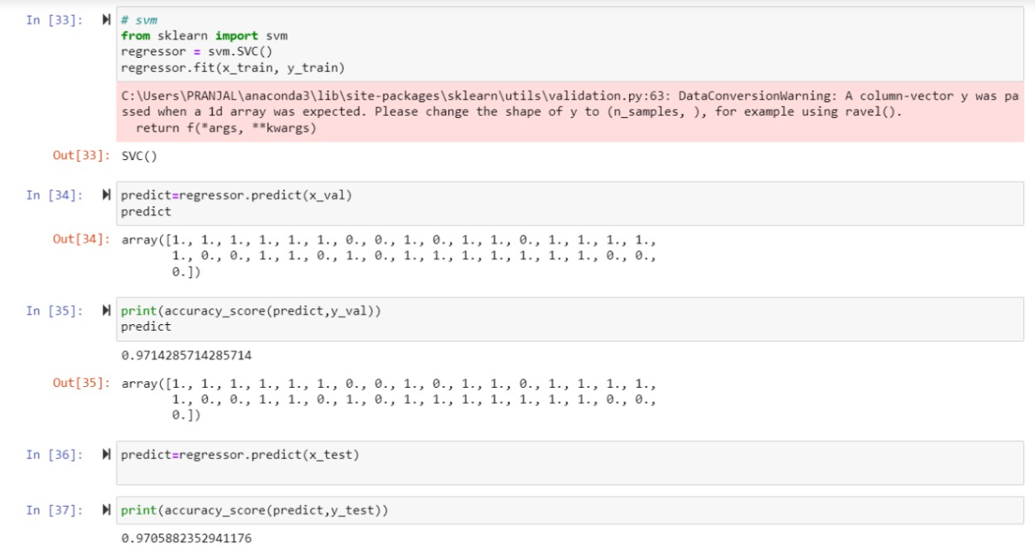

Slide 23
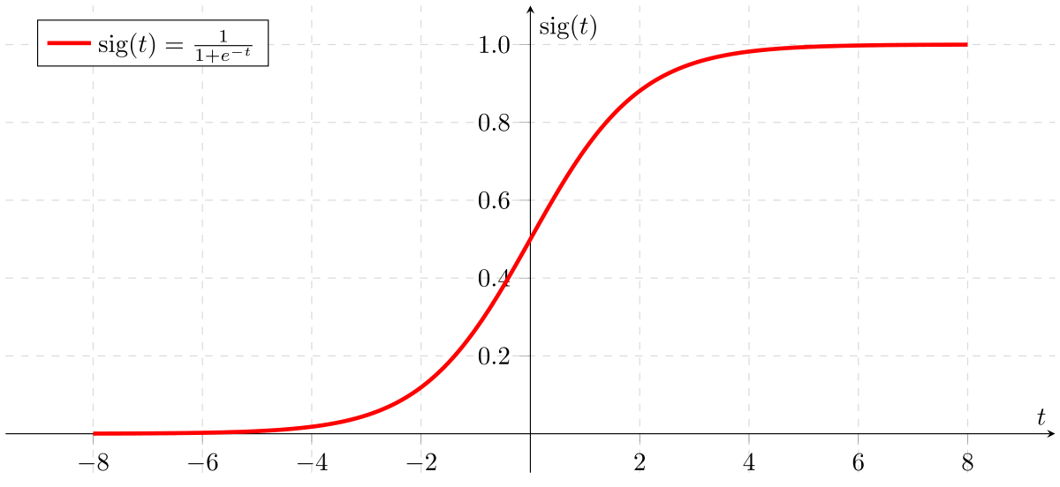
Logistic regression
Supervised learning classification algorithm
Used to predict probability of target value.
Nature of target value is only 0 or 1
[1 = yes/ success]
Applications: Used in spam detection,
diabetes prediction, cancer detection, etc.
Types:
Binary or binomial: 0 or 1 are outcomes possible
Multinomial: 3 or more outcomes of unordered types: type A B C
Ordinal: 3 or more outcomes of ordered types: poor good excellent
Regression models:
Binary logistic regression model
Multinomial logistic regression model

Slide 24
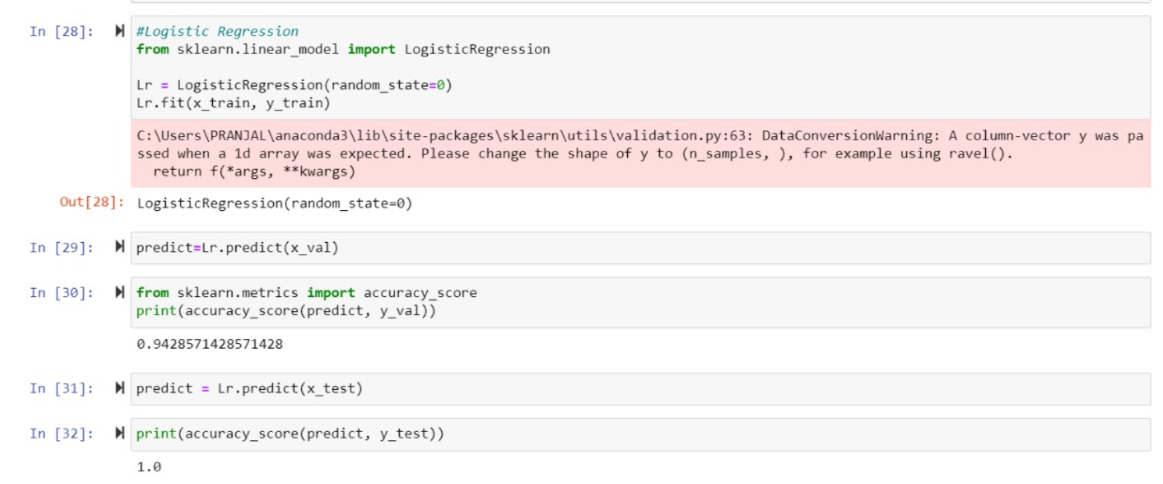
Notes:
Random_state = 0 in LogisticRegression() because we don’t need random splitting of data for training, we have done the splitting part.

Slide 25
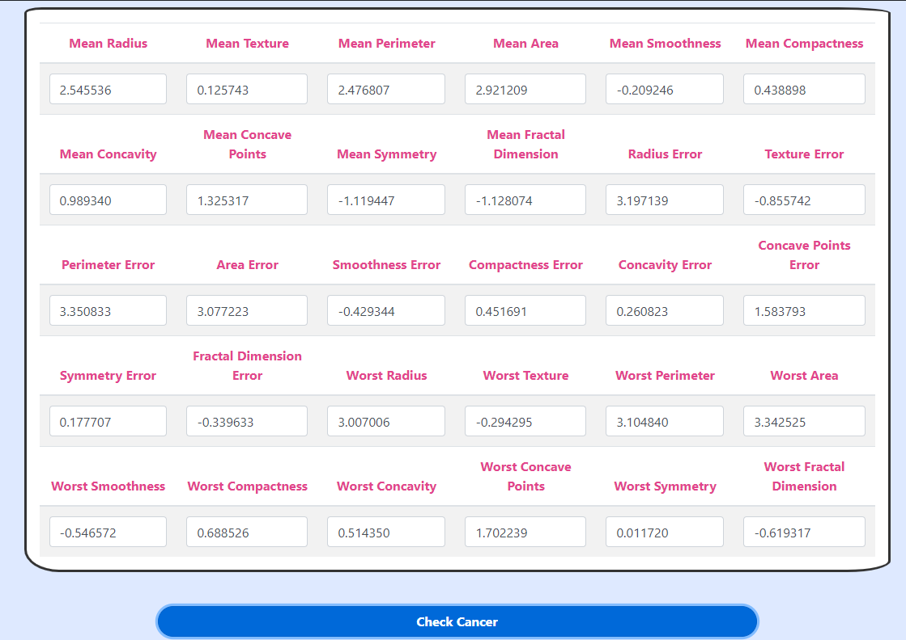
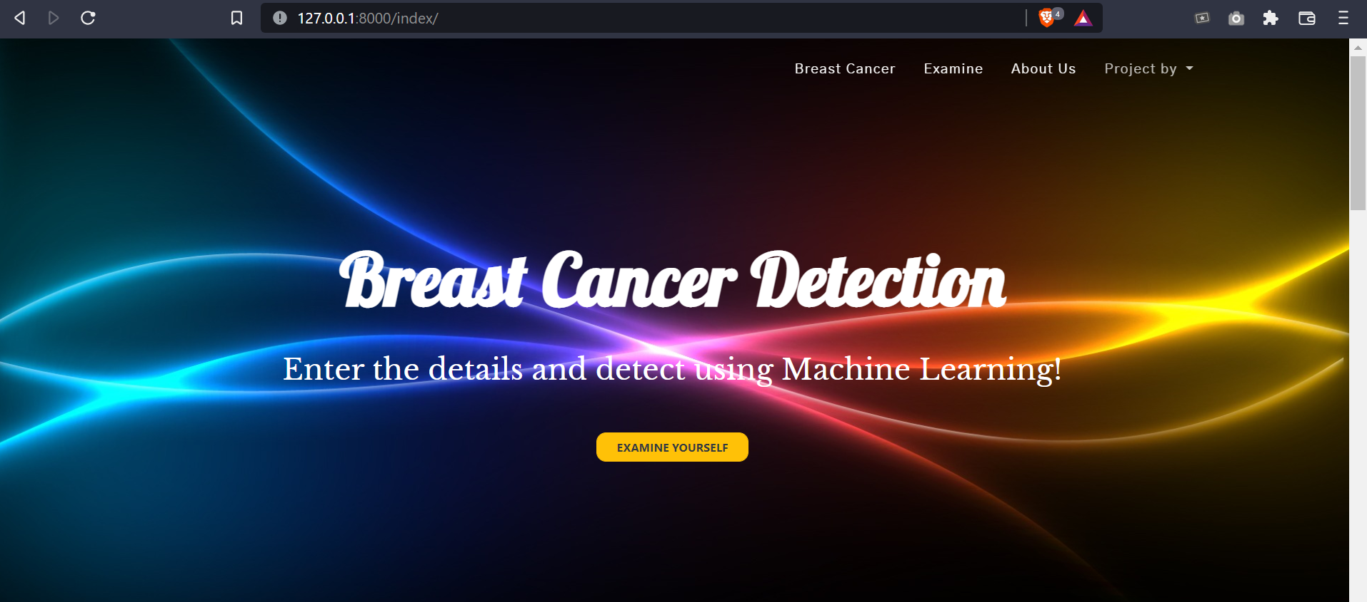

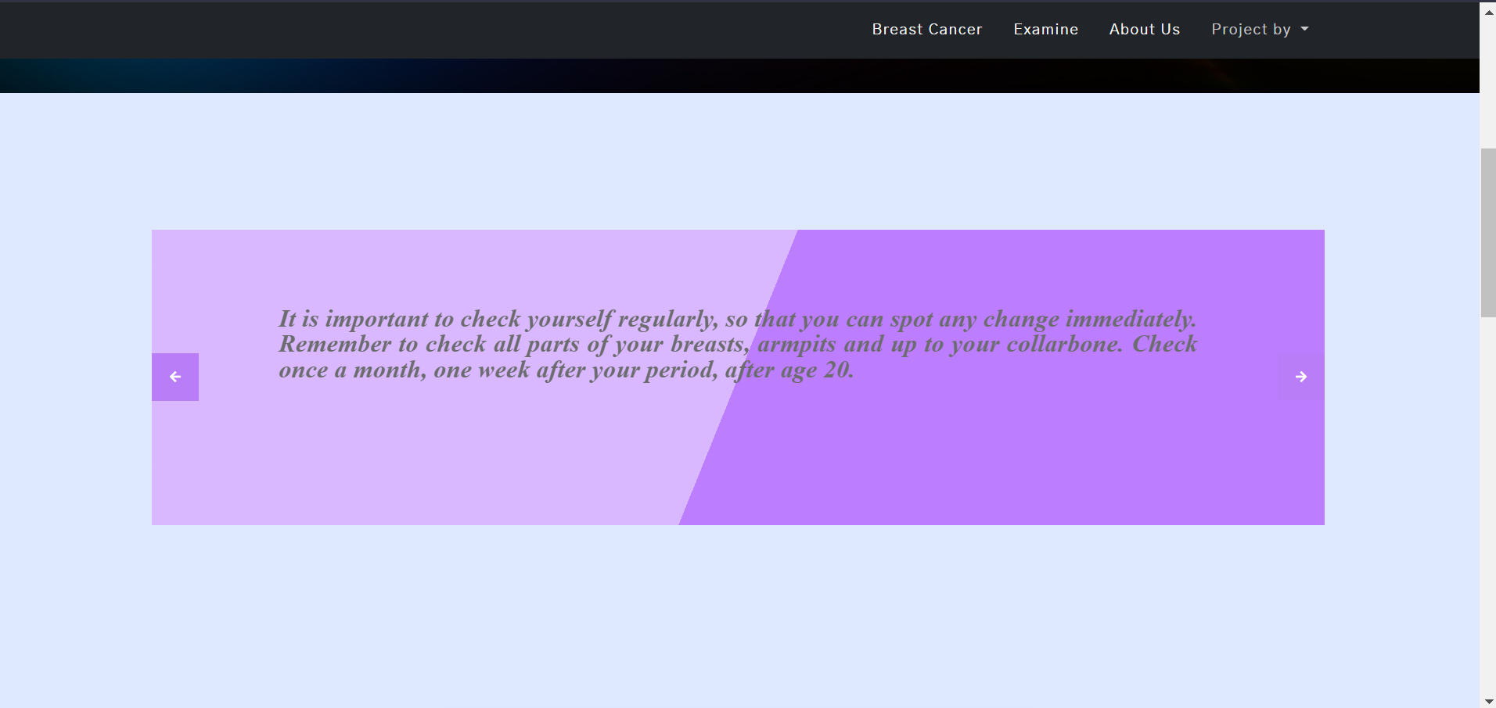


Front End components:
Notes:
Banner and Navbar:
Carousel:
Table: form method: post
Breadcrums: for output
Footer:

Slide 26
/07
LIMITATIONS & FUTURE SCOPE
Limitations of the code & Scope of betterment in the coming future

Slide 27
REALISTIC CONSTRAINTS
Economic: the project can be carried out from financial perspective
Environmental: there is no harm to environment as it is a software based project.
Health and Safety: Project is purely designed for healthcare of people and it can be “safe” unless the ML model fails to predict cancer.
Manufacturability: it can be manufactured in accepted costs efficiently
Sustainability: project copes with present requirements keeping in mind of the future needs as well.
Social: Project addresses social or human needs [healthcare]
Ethical: it is prepared with code of conduct.

Slide 28
MAINTAINABILTY
Software maintainability is defined as the degree to which an application is understood, repaired, or enhanced. Software maintainability is important because it is approximately 75% of the cost related to a project!
As such no failures can be detected in the project unless it is a failure in detecting cancer by the ML model we have implemented.
It can always improve its accuracy by testing and training larger datasets, and this data keeps on increasing always.
So there is always a scope of betterment.
As Maintainability is the ability of the system to support change, therefore our project is maintainable according to this aspect.

Slide 29
LIMITATIONS
In this project, we cannot gaurantee the accuracy, which is good but not so great as people's lives are on the line.
So we have to increase it a lot further so that it can be made sure that results are accurate to be used by doctors.
Working on parametric data and not on pictorial data [scanning of X-Rays].
Also this project needs to be deployed in the production level, because currently it is running in the local machines.

Slide 30
FUTURE SCOPE
Increase the accuracy of the ML model
Since, access to proper measurement or dataset is limited, the ML model can be modified to be trained on images of the lump.
Enhance the frontend.
Deploying the website.

Slide 31
/08
CONCLUSION
Accuracy & Results derived

Slide 32

CONCLUSION
Machine Learning has a vast application in medical science and can be helpful in detecting many such similar health issues. It has vast application in the field of healthcare.
It is important to understand that breast cancer can occur in the younger population as well. Also, many young breast cancers tend to be very aggressive and have to be tackled in proper sequence of surgery and other treatments, and needless to say, early detection of breast cancerwill definitely give high cure rates.
Above points are all pointing to one necessity - 'Detect Breast Cancer Early’. Since the number of cases are rising, more women are getting affected, most are presenting only after symptoms develop (so usually stage 2B and beyond, rarely earlier stage) and we cannot prevent this cancer, all we can do is to detect this cancer early.

Slide 33
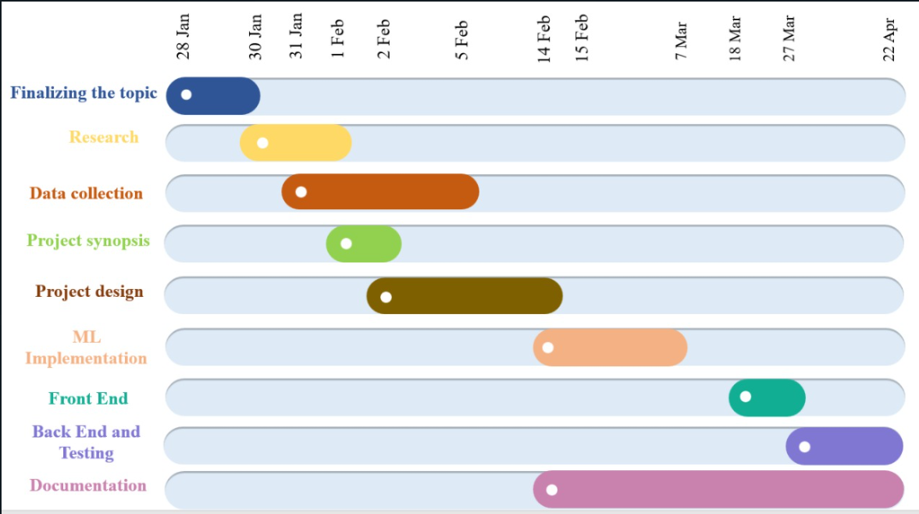
TIMELINE [GANTT CHART]

Slide 34
THANK YOU !

